Slide 1
Selenium
where there is no API

Slide 2
Problem
No systemic way to view fulfillment unit rules
➔
rule drift
Actual policies not in place
Inconsistency

Slide 3
The Not So Good Solution
No API available!
Selenium web driver
Driving interactions with web pages and forms
pandas
Parsing data into excel
Transforming dimensions of data into readable format
Use case in Code4Lib Journal
https://journal.code4lib.org/articles/13197

Slide 4
What is a web driver?
What it does
Interacts with website just like human would
Visits pages
Clicks on links
Allows you to retrieve data in page
Environment
Python Selenium libraries
Browser specific driver executable on local machine

Slide 5
Goals for this Project
Aggregate loan rule data for each fulfillment unit into a single spreadsheet
Loan rule
Name
Parameters
enabled
Fulfillment unit locations
TOUS
Into a single line

Slide 6

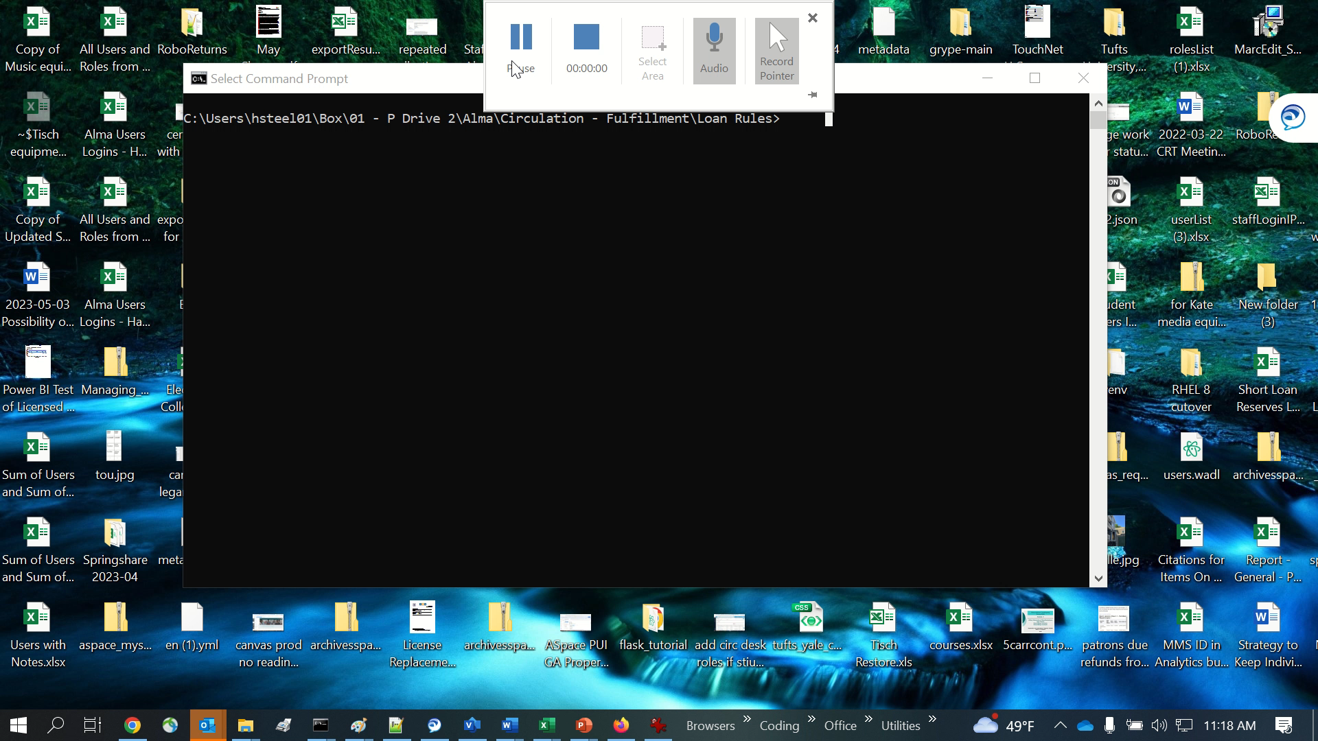

Slide 7
Requirements
Version of web driver executable compatible with your browser version
For Chrome: https://chromedriver.chromium.org/downloads
Put unzipped web driver executable in your home directory and reference in script
Python requirements
pandas, numpy, and selenium
In requirements.py
python –m pip install –r requirements.py
OR (if only one Python install) python pip install –r requirements.py
Alma
System user in Alma with Fulfillment Administrator role at institution level
Config file secrets_local.py
Alma username and password, institutional Alma URL

Slide 8
How it works
Create a web driver object that will fire a web browser instance
As user agent
driver = webdriver.Chrome(executable_path=r'path/to/chromedriver')

Slide 9
How it Works - Log in
element = driver.find_element(By.ID, 'username')
time.sleep(2)
element.send_keys(username)
element = driver.find_element(By.ID, 'password')
element.send_keys(password)
element.send_keys(Keys.RETURN)

Slide 10
How it Works – Other ways to find elements
Using “By.XPATH” as method argument
element = driver.find_element(By.XPATH, "//*[contains(@id, 'ROW_" + str(y) + "_COL_activeImage')]/div")
Allows XPATH to search tree, and XPATH methods like you’d use in XSL

Slide 11
How it Works – Waiting and Executing
Elements need to be interactable for Selenium to retrieve them
Different parts of the page can take longer to load
Implicit
Better because execution as soon as page is ready
wait = WebDriverWait(driver, 20)
element = wait.until(ec.visibility_of_element_located((By.ID, 'input_fulfillmentUnits_' + str(full_unit_number))))
element.click()
Explicit
Necessary for non-Selenium functions
time.sleep(3)

Slide 12
How it Works – pandas
Data science to reshape data
Multiple columns and rows from multiple tables into single output column
Reading and writing from tables and into Excel

Slide 13
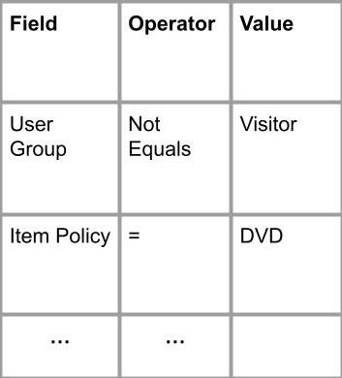
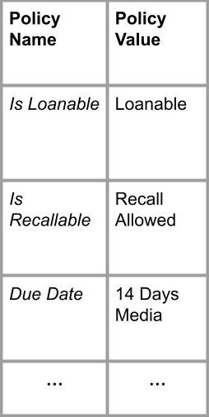
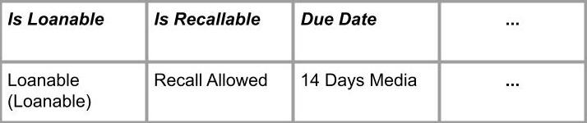
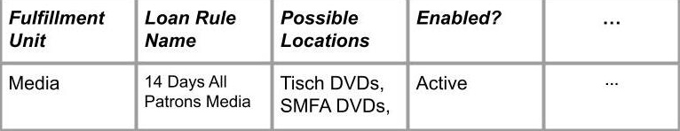
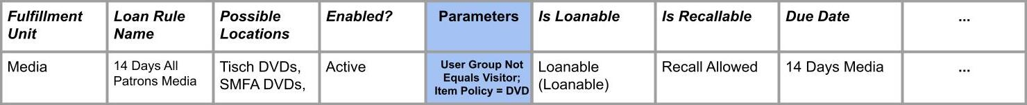
for z in range(0, len(parameter_df)):
parameter_list.append(parameter_df.loc[z, 'Name'] + " " + parameter_df.loc[z,'Operator'] + parameter_df.loc[z, 'Value'])
parameter_string = "; ".join(parameter_list)
tou_df = tou_df[['Policy Name', 'Policy Type’]]
tou_df = tou_df.set_index('Policy Type’)
tou_series = tou_df.squeeze()
rule_df = rule_df.join(tou_series.to_frame(rule_df.index[0])
Read TOU HTML Table into dataframe
html = driver.page_source
tou_df = pd.read_html(html)[0]
Make TOU dataframe into series TOU Series
html = driver.page_source
parameter_df = pd.read_html(html)[0]
Convert multi column dataframe to statement
Parameter Table
Append series to end of existing loan rule row
User Group Not Equals Visitor; Item Policy = DVD

Slide 14
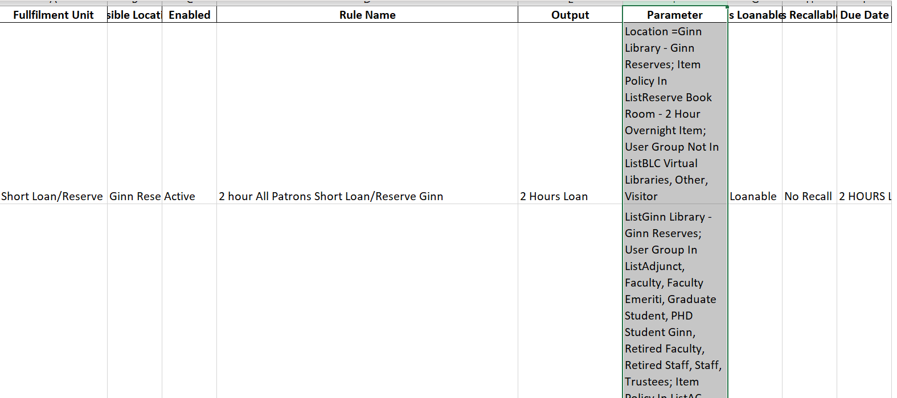
Results

Slide 15
Caveats
Driver mimics human user ➔ same pitfalls
Driver needs to be updated with versions of Chrome
Waiting: explicit or implicit

Slide 16
Questions?

Slide 17
References
https://github.com/TuftsUniversity/alma-retrieve-loan-rules-and-tous
https://journal.code4lib.org/issues/issues/issue39
https://realpython.com/modern-web-automation-with-python-and-selenium/
https://selenium-python.readthedocs.io/

